Slide 1
Accepting AS-1 RBC as primary inventory at Seattle Children’s
Nabiha Huq Saifee, MD, PhD
Updated November 2021

Slide 2
Situation: Bloodworks NW and American Red Cross will both be primarily collecting RBCs in AS-1 additive solution
Background:
  Currently, Seattle Children’s is using primarily AS-3 RBCs from both Bloodworks NW and American Red Cross.
  Bloodworks will no longer produce AS-3 RBCs and American Red Cross has very limited number of AS-3 RBCs.
  AS-1 has mannitol with theoretical risk of renal toxicity or decreased cerebral blood flow from brisk diuresis, but not seen in institutions using AS-1 for neonates including for large volume transfusion/ECMO.
Assessment:
  We will need to accept AS-1 RBCs to maintain inventory
  There is evidence for safe use of AS-1 RBCs in all patients including neonates receiving large volume transfusion/ECMO therapy.
Recommendation:
  Accept AS-1 RBCs for routine use in all patients at Seattle Children’s

Slide 3
Comparison of AS-1 and AS-3 Constituents: main difference is mannitol in AS-1
 | CPD/AS-1 |  | CP2D/AS-3
Constituent/ Variable | CPD anticoagulant | Adsol® (AS-1) additive solution | CP2D anticoagulant | Nutricel® (AS-3) additive solution
Volume (mL) | 70* | 110 | 70* | 110
pH | 5.3 – 5.9 |  | 5.3 – 5.9
Sodium Chloride (mg) | 0 | 990 | 0 | 451
Citric Acid (mg) | 206 | 0 | 229 | 46
Tri-sodium citrate (mg) | 1660 | 0 | 1840 | 647
Dextrose (mg) | 1610 | 2420 | 3570 | 1210
Adenine (mg) | 0 | 30 | 0 | 33
Sodium Phosphate (mg) | 140 | 0 | 155 | 304
Mannitol | 0 | 825 | 0 | 0
*About 85% of CPD or CP2D plasma is removed after centrifugation of donated whole blood.
Notes:
Additive constituents: Sodium, Chloride, Citrate, Dextrose, Adenine, Phosphate

Slide 4
Studies with Routine Transfusions
Reference | Neonates | Control Group | Study Group | Dose | Age of Blood
Gooch 1986 | 11 | CPDA-1 | AS-1 | 10 mL/kg | <5 days
Goodstein 1993 | 16 | CPDA-1 | AS-1 | 17 mL/kg | <5 days
Strauss 1996 | 40 | CPDA-1 | AS-1 | 15 mL/kg | <7 days vs ≤ 42 days
Strauss 2000 | 54 | CPDA-1 | AS-3 | 15 mL/kg | <7 days vs ≤42 days
Mangel 2001 | 56 | Historical CPDA-1 group | AS-3 | 7 mL/kg | ≤35 days
Jain 2001 | 174 | Historical CPDA-1 group | AS-1 | 15 mL/kg | ≤35 days vs ≤42 days
Six studies with CPDA-1 vs AS-1 or AS-3
No significant differences in laboratory values or adverse events
Studies have shown small volume transfusions (15mL/kg or less) with RBCs stored in additive solution are safe
Notes:
Different age of product, type of solution, dose transfused
No evidence of hyperglycemia, hypoglycemia, hypocalcemia, hyperkalemia, hyponatremia

Slide 5
Quantity (mg/kg) of Additives Infused with 15mL/kg RBC transfusion (HCT 60%)
Additive (total mg/kg infused) | Adsol® (AS-1) | Nutricel® (AS-3) | Theoretical Dose to Avoid
Sodium Chloride | 42 | 7.5 | 137 mg/kg/day
Dextrose | 129 | 42 | 240 mg/kg/hr
Adenine | 0.6 | 0.6 | 15 mg/kg/dose
Citrate | 9.8 | 12.6 | 180 mg/kg/hr
Phosphate | 2.0 | 5.6 | >60 mg/kg/day
Mannitol | 33 | 0 | 360 mg/kg/day
33mg/kg mannitol given per 15mL/kg transfusion of AS-1 RBC compared to 250-500mg/kg dosing for edema or raised intracranial pressure
Need >100-200 mL/kg transfusions to reach this therapeutic mannitol dosing for edema
Added to
Strauss RG. Chapter 6 In: Herman JH, Manno CS, eds. Pediatric Transfusion Therapy, AABB Press.
Luban NL, Strauss RG, Hume HA. Transfusion 1991; 31: 229-35.
Notes:
Slow infusion rates generally permits metabolism and distribution of additives from blood into extravascular sites.
Dextrose, adenine, phosphate enter red cells and are not necessarily in extracellular solution

Slide 6
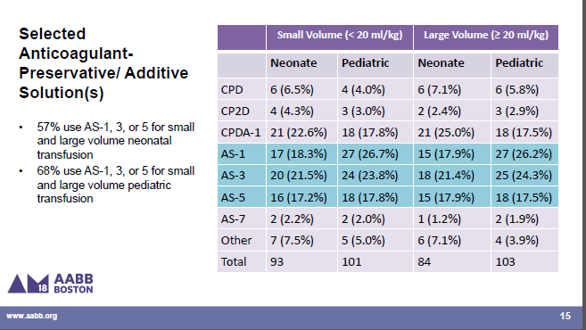
~36% of centers used AS-1 or AS-5 (mannitol containing AS) for neonatal large volume transfusions
Web-based survey of 221 US centers Apr 2017-Jan 2018
Abstract Presentations from the AABB Annual Meeting Boston, MA, October 13–16, 2018
Reeves HM et al. Transfusion 2021; 61:2265-2276.

Slide 7
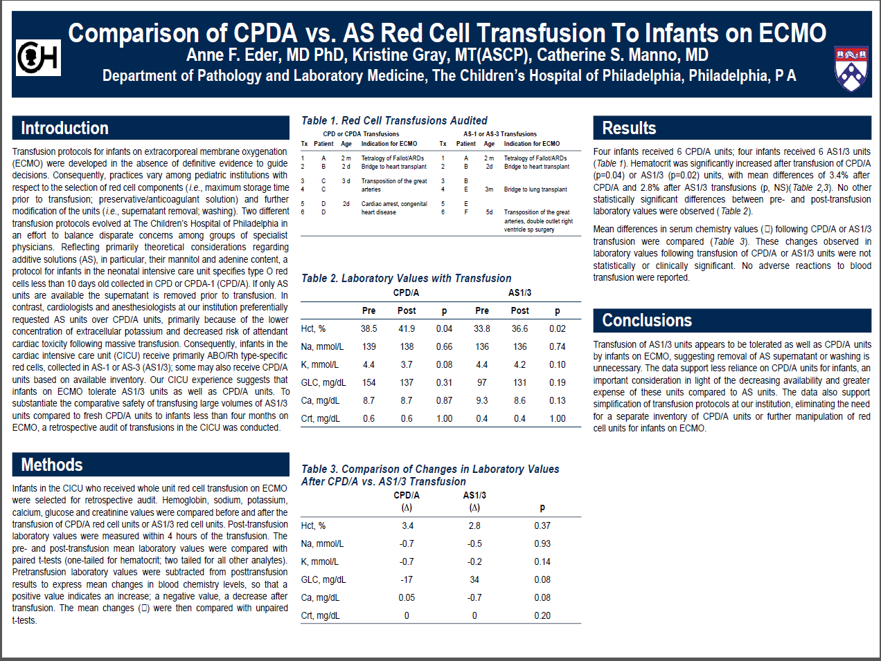
AS-1 and AS-3 RBCs is utilized in neonates on ECMO (CHOP abstract 2002)
AS-1 and AS-3 used interchangeably for all patients including ECMO and MTP with no issues at CHOP and Cincinnati Children’s
Majority inventory at both CHOP and Cincinnati is AS-1

Slide 8
Proposal at Seattle Children’s
Accept AS-1 RBCs for use in all patients
Use AS-1 and AS-3 RBCs received from BloodworksNW and American Red Cross interchangeably including for emergency blood refrigerator/massive transfusion and patients receiving ECMO therapy.

