Slide 1
What is the difference between A₁ and A₂?
Malcolm Needs CSci FIBMS FBBTS

Slide 2
Biochemistry.
The amount of H antigen exposed to anti-H differs with the ABO group of the red cells¹ (not to scale).
Group O
Group A₂
Group B
Group A₂B
Group A₁
Group A₁B
Malcolm Needs CSci FIBMS FBBTS
Notes:
2

Slide 3
From the previous slide, it is easy to see that there is, without doubt, a quantitative difference between A₁ and A₂.
Malcolm Needs CSci FIBMS FBBTS

Slide 4
There is only about 10% of the A transferase in A₂ individuals compared with A₁ individuals².
Malcolm Needs CSci FIBMS FBBTS

Slide 5
There is, however, also a qualitative difference.
The ABH antigens are found on oligosaccharide “backbone” molecules.
Malcolm Needs CSci FIBMS FBBTS

Slide 6
There are a minimum of 4 such “backbones” (probably 8); Types 1 to 4, with most of the antigens being on types 1 and 2.
Malcolm Needs CSci FIBMS FBBTS

Slide 7
The A₁ antigen is found on all 4 of these “backbones”, but the A₂ antigen is only found on Types 1 and 2 (assuming the patients have an Se gene – otherwise neither will be on Type 1)².
Malcolm Needs CSci FIBMS FBBTS

Slide 8
This, and the fact that the enzymes have different pH optima, cation requirements and Michaelis constants confirms the qualitative difference².
Malcolm Needs CSci FIBMS FBBTS

Slide 9
Lectins to ABO Antigens.
Malcolm Needs CSci FIBMS FBBTS

Slide 10
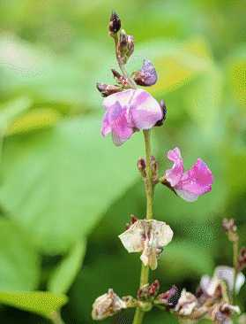
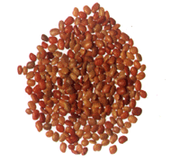
Dolichos biflorus (Horse gram).
Malcolm Needs CSci FIBMS FBBTS

Slide 11
Amongst the best known lectin in the serologist’s tool kit, but beware!.
The lectin also agglutinates A, B, AB and O red cells that are Cad+ or Tn+.
Malcolm Needs CSci FIBMS FBBTS

Slide 12
References.
    Reid ME, Lomas-Francis C. The Blood Group Antigen FactsBook. 2nd edition, 2004, Academic Press.
    Klein HG, Anstee DJ. Mollison’s Blood Transfusion in Clinical Medicine. 12th edition, 2014, Wiley Blackwell.
Malcolm Needs CSci FIBMS FBBTS

